Slide 1
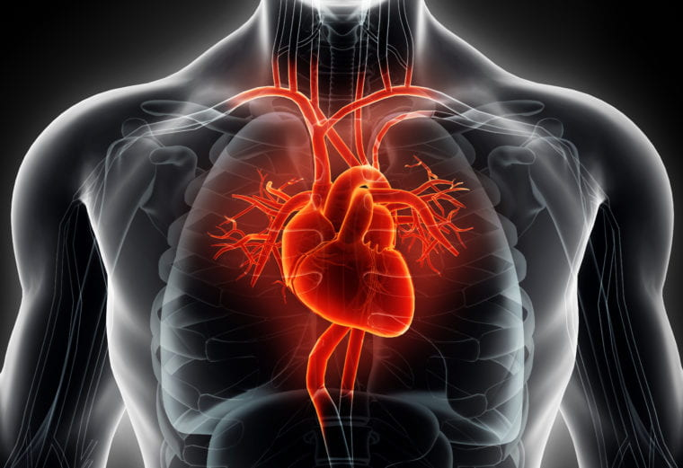

PREDICTING THE TEN-YEAR RISK OF DEVELOPING HEART DISEASE USING MACHINE LEARNING

Slide 2
Done by
01
Nada Aboubakr
02
Dalia Mamdouh
program:
IBM Data Scientist
group:
ALX_AIS3_M1d
03
Hassan Elsayed
04
Khaled Elnhas
05
Ahmed Elkomi
06
Mohamed Hassan

Slide 3

Introduction to Heart Disease
Heart disease remains a leading cause of mortality globally. Understanding its risk factors is crucial for prevention. This project utilizes machine learning techniques to forecast the risk of heart disease over a decadal timeframe, offering insights into effective interventions.

Slide 4

Objective
The project focuses on predicting the 10-year risk of heart disease, specifically coronary artery disease (CAD), using machine learning. By analyzing clinical and lifestyle data, the model aims to help healthcare professionals identify high-risk individuals early and support preventive healthcare efforts, ultimately reducing mortality rates.

Slide 5
Problem Statement
Early detection of coronary artery disease (CAD) is crucial for reducing fatality rates, but traditional clinical risk calculators may miss hidden patterns in patient data. This project aims to develop a machine learning model, to predict the ten-year risk of heart disease. By analyzing factors like age, cholesterol, and blood pressure, the model can offer a more accurate and dynamic approach to risk prediction, improving early intervention and patient outcomes.

Slide 6
Dataset Description
Dataset Source
The "Framingham Heart Study" dataset was obtained from Kaggle and includes 4,240 anonymized patient records with key clinical metrics for predicting the 10-year risk of coronary artery disease.
Key Features
The dataset includes demographic and clinical features such as age, gender, education, smoking habits, blood pressure, cholesterol levels, BMI, diabetes, heart rate, and glucose levels.
Target Variable
The target variable, "TenYearCHD," is a binary indicator predicting whether a participant will develop coronary heart disease within ten years (0 = no, 1 = yes).

Slide 7
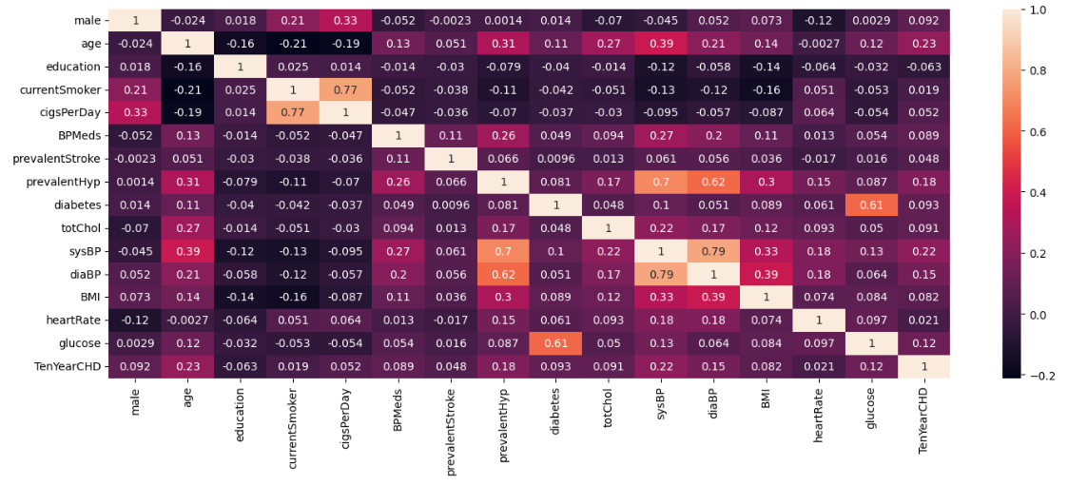
Data Visualization
Data Visualization Techniques
Correlation Heatmap: Showed relationships between features like age, blood pressure, and cholesterol.

Slide 8
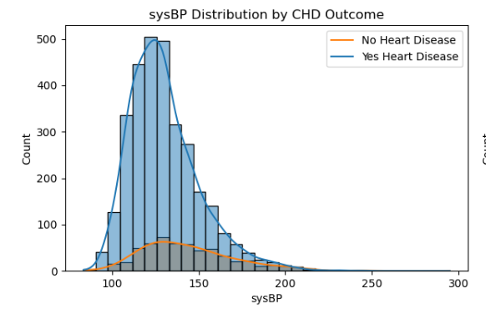
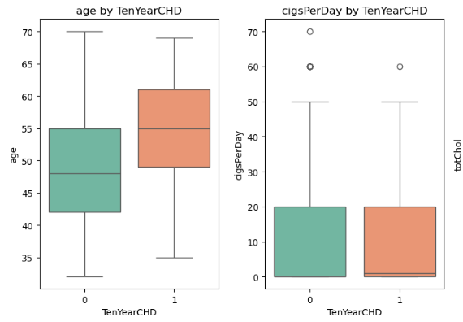
Data Visualization
Data Visualization Techniques
2. Histograms & Box Plots: Visualized distributions and identified outliers in features like SysBP, cigsPerDay, and age.

Slide 9
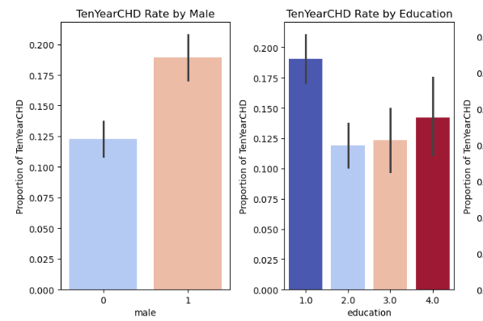
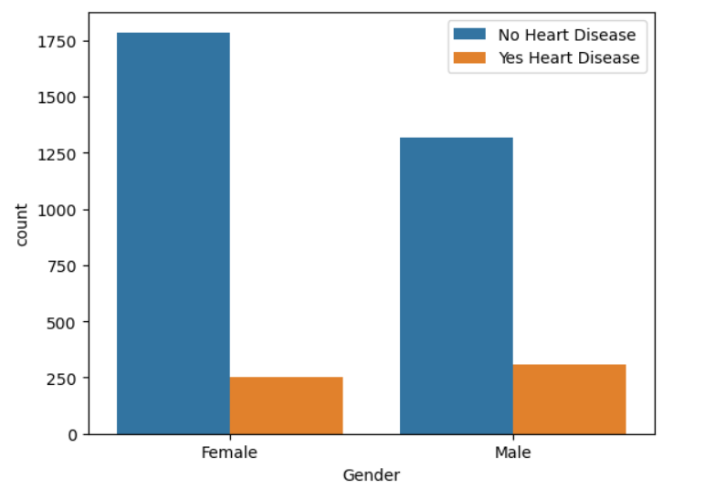
Data Visualization
Data Visualization Techniques
3. Bar Charts & Count Plots: Highlighted the proportion of smokers and the frequency of heart disease across gender and education.

Slide 10
Data Cleaning and Preprocessing
Handling Missing Values:
Normalization
Skewed Data
Categorical Data Encoding
Numerical features like age, cholesterol, blood pressure, and BMI were normalized using Standard Scaling to ensure consistent feature ranges for better model performance.
Log transformations were applied to highly skewed features like glucose, BPMeds, and cigsPerDay to reduce skewness and enhance model accuracy.
Rows with missing critical data, such as glucose (388 entries) and BPMeds (53 entries), were removed, reducing the dataset to 3,658 entries.
Categorical variables, such as male (1 = male, 0 = female) and currentSmoker, were converted into numerical formats for model training.

Slide 11
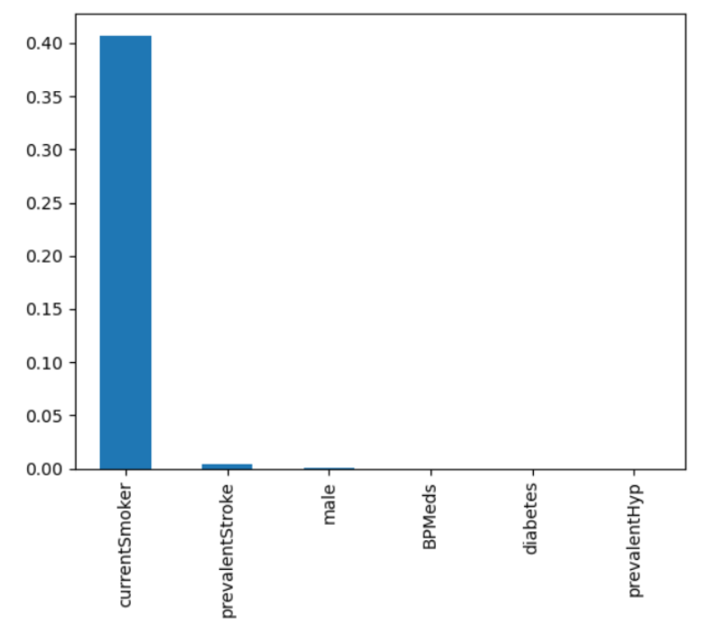
Feature Selection & Model Development
Feature Selection & Balancing
Chi-Square Test: Applied to identify significant categorical features; for example, 'is_smoking' was found not statistically significant (p > 0.05).

Slide 12
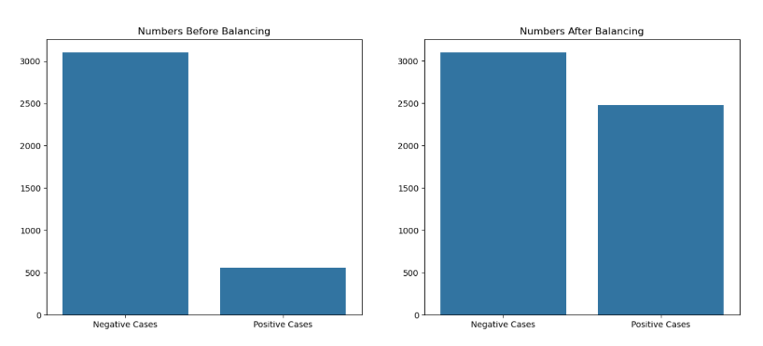
Feature Selection & Model Development
Feature Selection & Balancing
SMOTE: Used to balance the dataset by generating synthetic samples for the minority class, improving model fairness​.

Slide 13
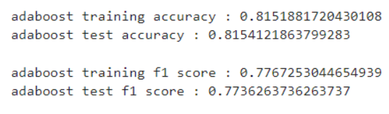
Feature Selection & Model Development
Model Selection
Algorithms Used: Decision Tree Classifier, Support Vector Machine (SVM), and AdaBoost.
Best Performing Model: AdaBoost outperformed others, and its hyperparameters were further tuned for optimal results​.

Slide 14
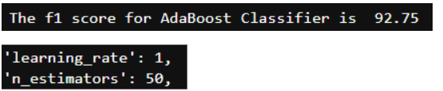
Feature Selection & Model Development
Model Optimization
Tuning Process: The Decision Tree Classifier was first optimized (depth and minimum samples per leaf), and then integrated into the AdaBoost framework. AdaBoost itself was tuned to improve its classification performance.

Slide 15
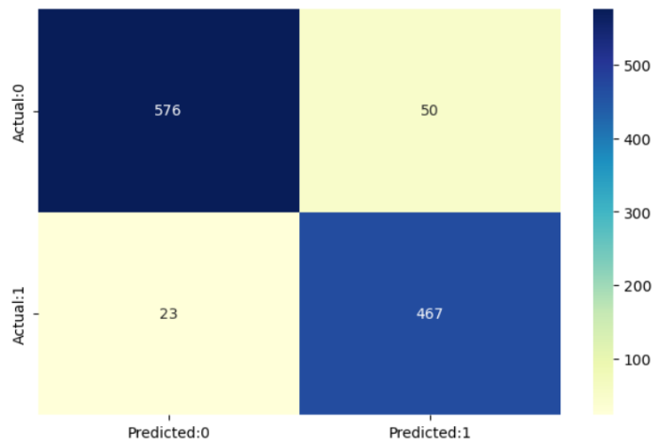
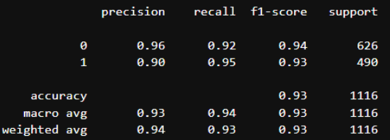
Results
Performance Metrics
Confusion Matrix

Slide 16
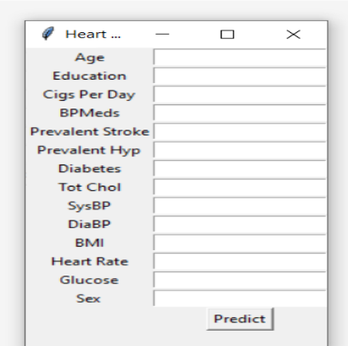
Model Deployment
Graphical User Interface (GUI)
Developed to make the prediction process intuitive and user-friendly, allowing users to input personal health data easily.

Slide 17
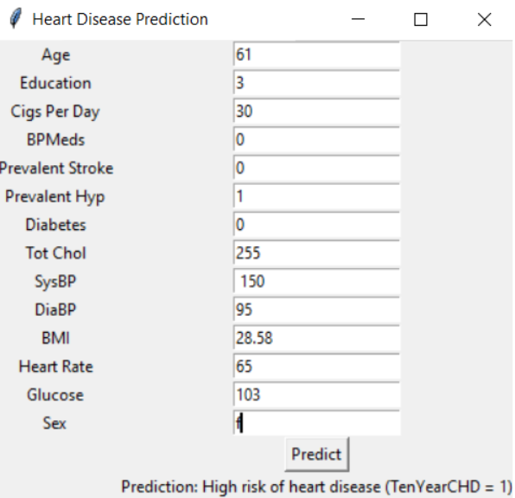
Model Deployment
Input Features
The GUI collects various health metrics such as age, education, cigsPerDay, blood pressure, diabetes status, cholesterol, BMI, heart rate, and glucose levels.
Output
Provides a prediction of the user's 10-year risk of developing heart disease.

Slide 18
Thank you

